Slide 1
NVM Bench
Scripting in Perl

Slide 2
Perl basics
TMTOWTDI
Comments
#This is a comment
Data types
$scalar = 3; #$scalar = "three"; #$scalar = 3.5;
@array = (1, "two", 3);
%hash = ("key1" => 1, "key2" => "two");
Declarations
use strict; #require declarations
my $variable; #lexical scope (current code block)
our $module_variable; #package scope (default)
Notes:
TMTOWTDI: There’s More Than One Way To Do It (massive understatement for Perl)

Slide 3
Perl basics
Operators, Statement Terminators, Whitespace (Like C)
$result = ($a + $b)
* $really_long_variable_name;
File Write
Open (FILEHANDLE, ">$filename")
or die "Couldn't write $filename";
print FILEHANDLE $line;
close FILEHANDLE;
Notes:
Double quotes do “variable interpolation” which means that any variable names included in the string will be translated to the value of the variable at run time.

Slide 4
Perl basics
File Read
Open (FILEHANDLE, $filename)
or die "Couldn't read $filename";
while (<FILEHANDLE>)
{
#$_ stores current line
}
close FILEHANDLE;
Notes:
$_ and @_ are special “default variables” used extensively in perl when no variable is explicitly specified.

Slide 5
Perl basics
Functions
my ($z, $x2) = func($x, $y);
sub func
{
my ($x, $y) = @_;
$x++;
my $result = $x > $y ? $x : $y;
return ($result, $x);
}
Notes:
Function return may be scalar or list. Assignment to function return will “do the right thing” (fill as many values as possible starting from the first value returned, and populate the rest with undefined).

Slide 6
Perl basics
Modules
TestModule.pm
our @ISA = qw(Exporter);
our @EXPORT = qw(func1 func2);
sub func1
{
…
}
sub func2
{
…
}
1; #must return true at end of file

Slide 7
Perl basics
Modules
Script.pl
use FindBin;
use lib ("$FindBin::Bin", "$FindBin::Bin/..");
use TestModule;
func1();

Slide 8
Perl basics
Regular Expressions
# $string contains "Result = 1.30 V";
if ($string =~ /^Result\s*=\s*(\d+\.\d+)\s*(\w+)/)
{
($value, $units) = ($1, $2);
}
while (<FILEHANDLE>)
{
if (/.*(0x[A-F0-9]+)/)
{
$hexvalue = $1;
}
}

Slide 9
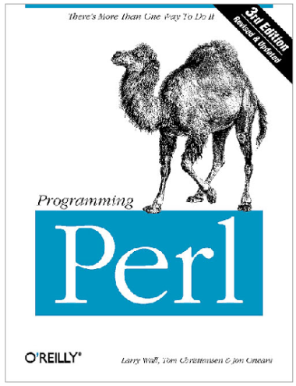
Perl basics
Resources
http://perldoc.perl.org
perldoc perldoc
From command prompt on a system with perl installed
Train classes?

Slide 10
Perl with NVM Bench
Executing commands from a perl script (testscript.pl)
use runcli; #imports runcli() and getcliresult()
my @CLIResults;
my @args = split (/,/,$ARGV[0]); #process input parameters from CLI
my $maxstep = $args[0];
RunCli("pu;rst;rs”);
my ($status) = GetCliResult(qr/Status\s*=\s*0x([A-F0-9]+)/);
…
for (my $step = 0; $step <= $maxstep; $step++)
{
@CLIResults = RunCli("somecommand($step)");
…
}

Slide 11
Perl with NVM Bench
Executing scripts from the CLI
>testscript(3)
Script path
Default
scripts directory within program root
Maverick: network share
Magnum: local drive synchronized with network share by launcher
Manual setting
>setpath(scripts,I:\Micron\Nextest\programs\Genesi_TC\scripts)
Notes:
Scripts may also be executed from a command prompt or from SCiTE debugger window.

Slide 12
Perl with NVM Bench
Directory organization and mirroring
Directories mirrored
scripts, macros, patterns: root plus special subdirectories
Example: scripts\GF
Mirrored conservatively from Boise server (\\bofs13\flash) to all sites requesting a particular program
For Genesi scripts, would a mirrored subdirectory be desired? Or is the root directory sufficient?
Discussion on making script paths multi-site friendly
http://moss.micron.com/MFG/pedevs/SiteDirectory/nand/nextest/User%20Guides/Nextest_individual_login_advanced_topics.htm

